Slide 1
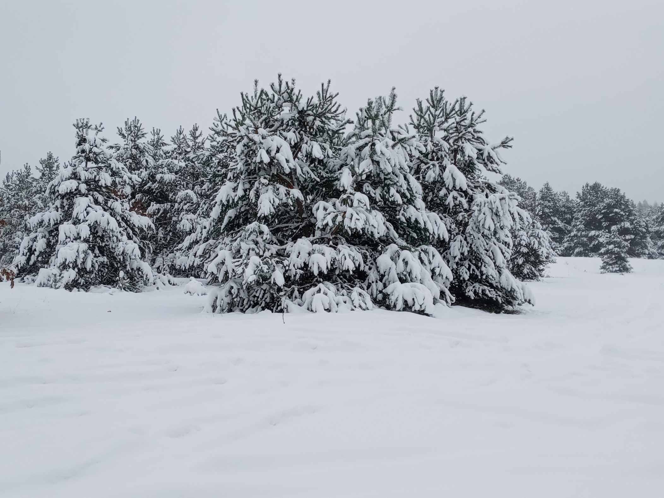
Winter Holidays

Slide 2
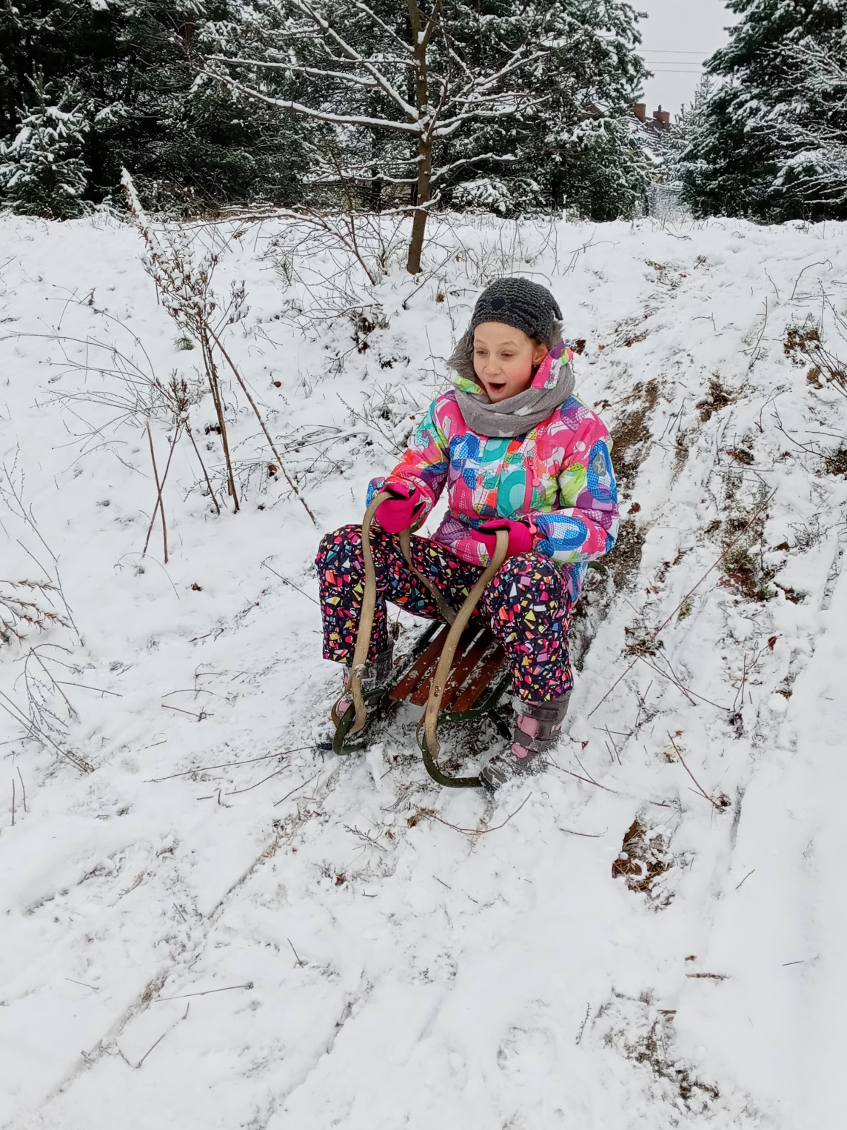
This year we started the holidays earlier than we planned. But it turned out to be good for us because we had a lot of snow. I spent the first week at home with my brother and my parents. Although many sports facilities like swimming pools, ice rinks were closed I spent my time very actively anyway.

Slide 3
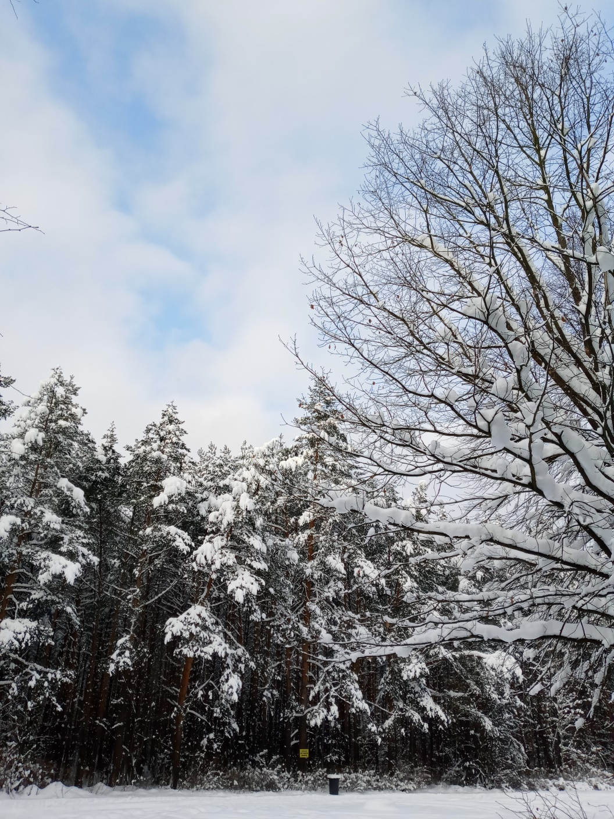
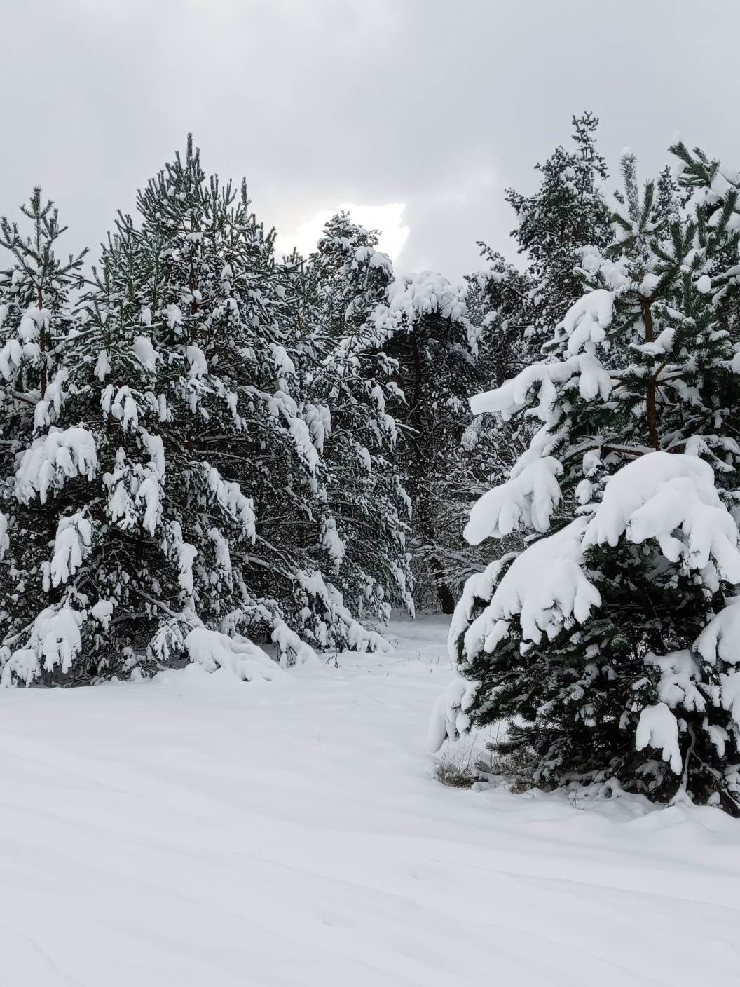

Slide 4
We went for walks to the forest and in the evenings we ran in the snow, playing with snowballs and making snowmen. The second week of the winter holiday I spent with my brother at my grandparents’ house in Jura Krakowsko - Częstochowska, where there was much more snow than in Dobrzykowice. This time skiing was not allowed and all ski slopes were closed. But there are a lot of fantastic smaller and bigger hills nearby, where I learned to ski a few years ago, and we used them for sledding.

Slide 5
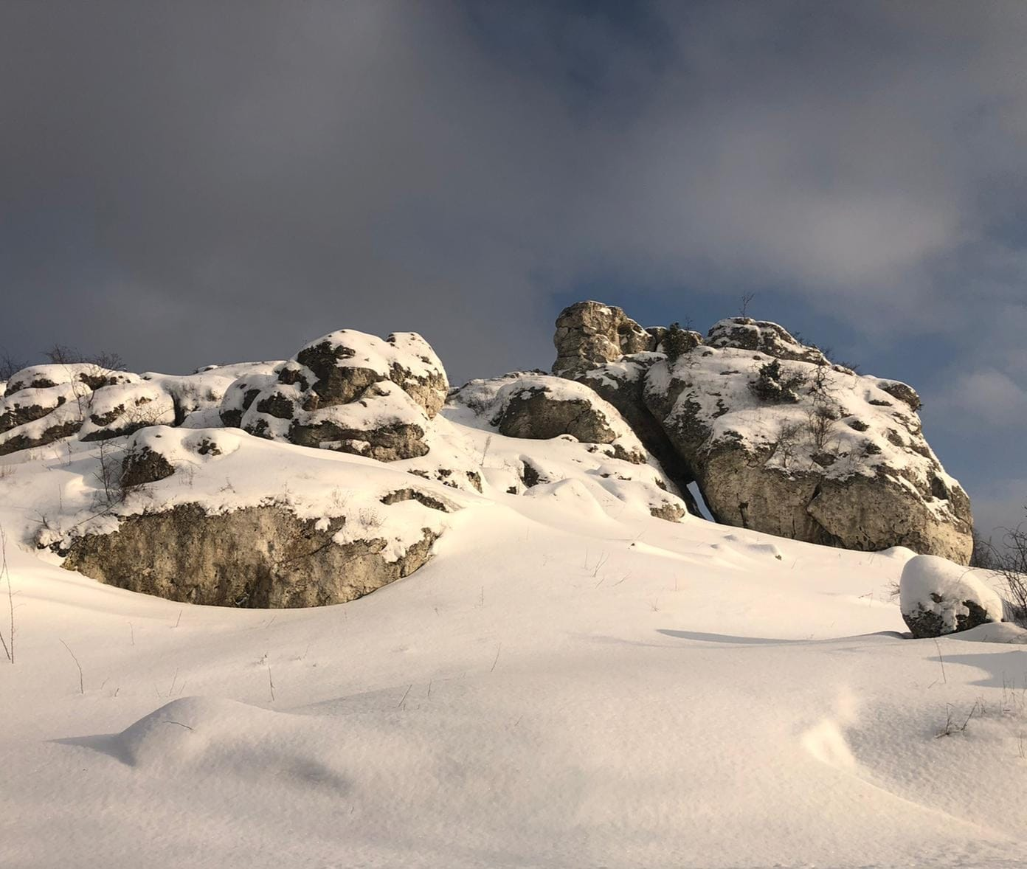

Slide 6
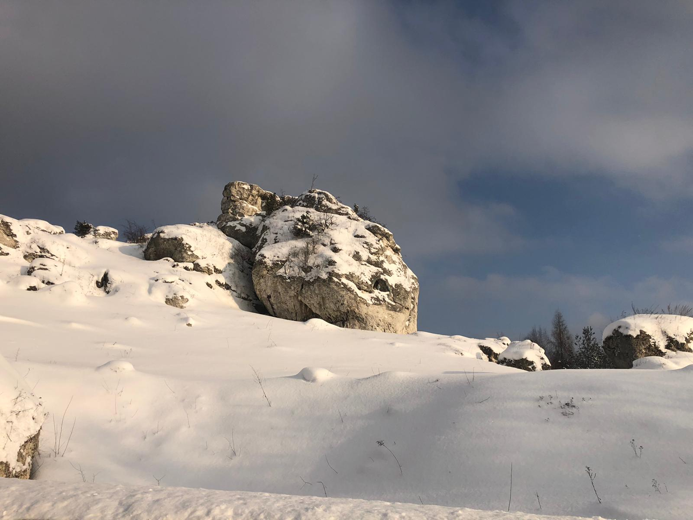

Slide 7
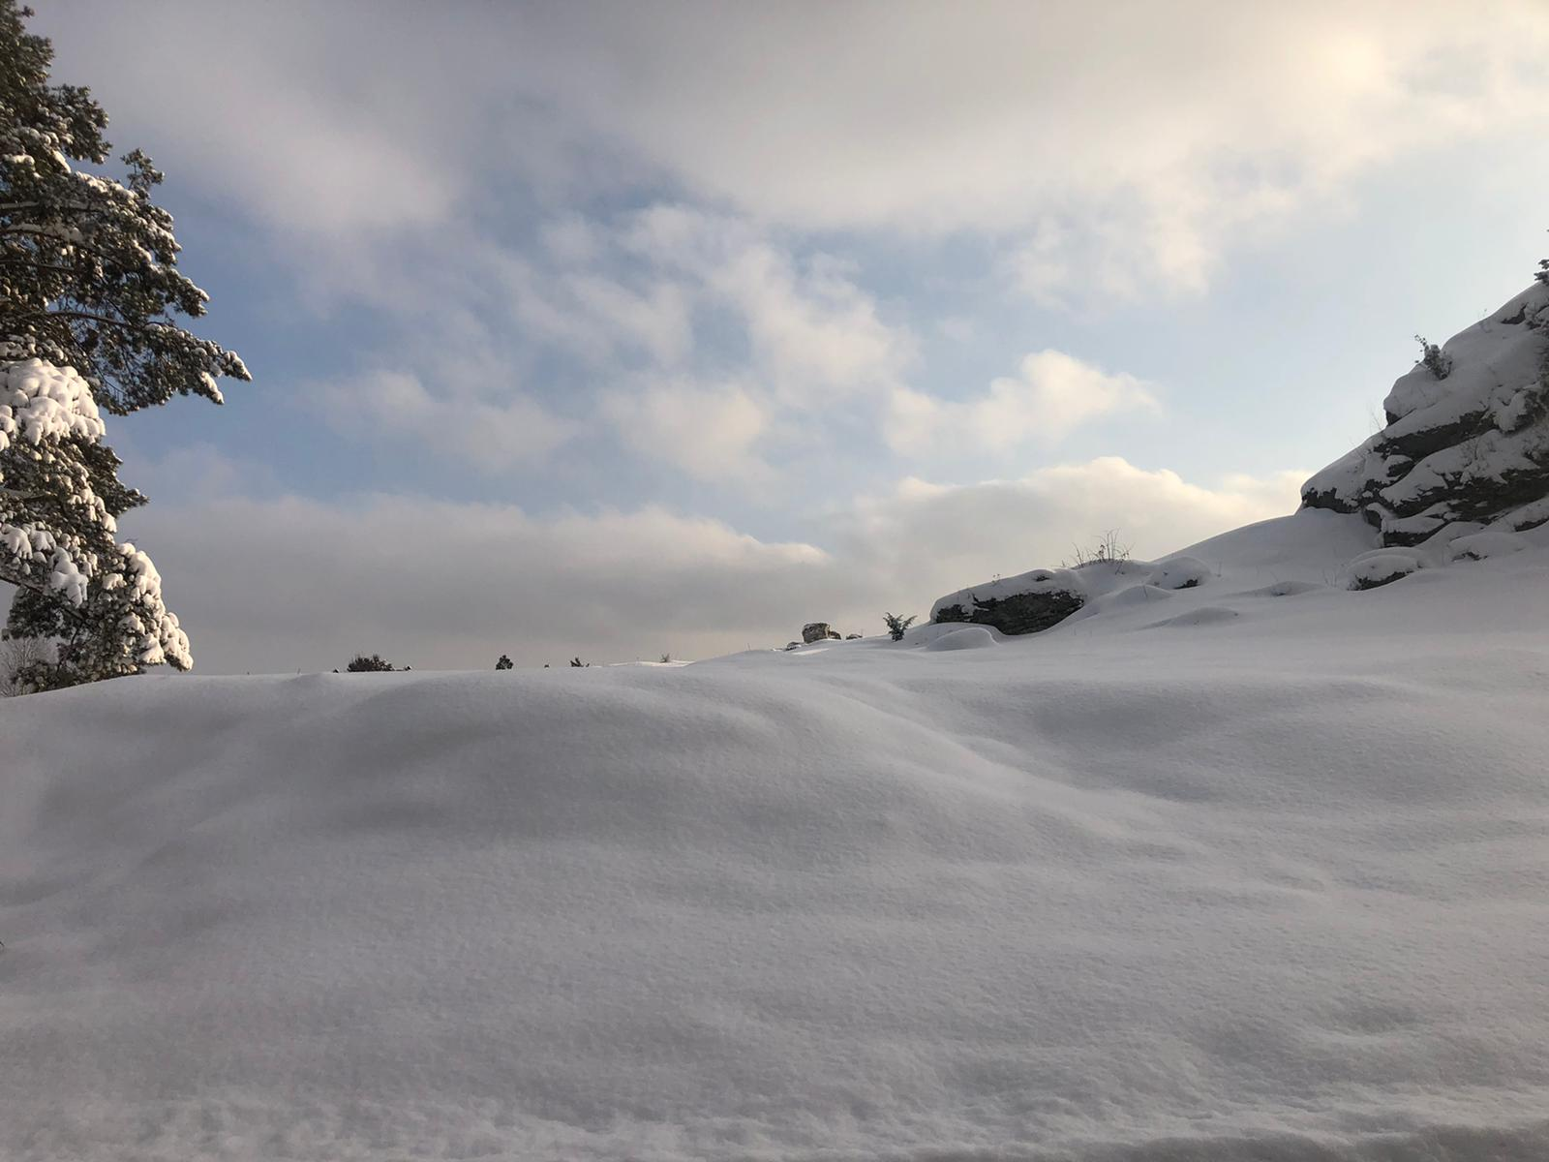

Slide 8
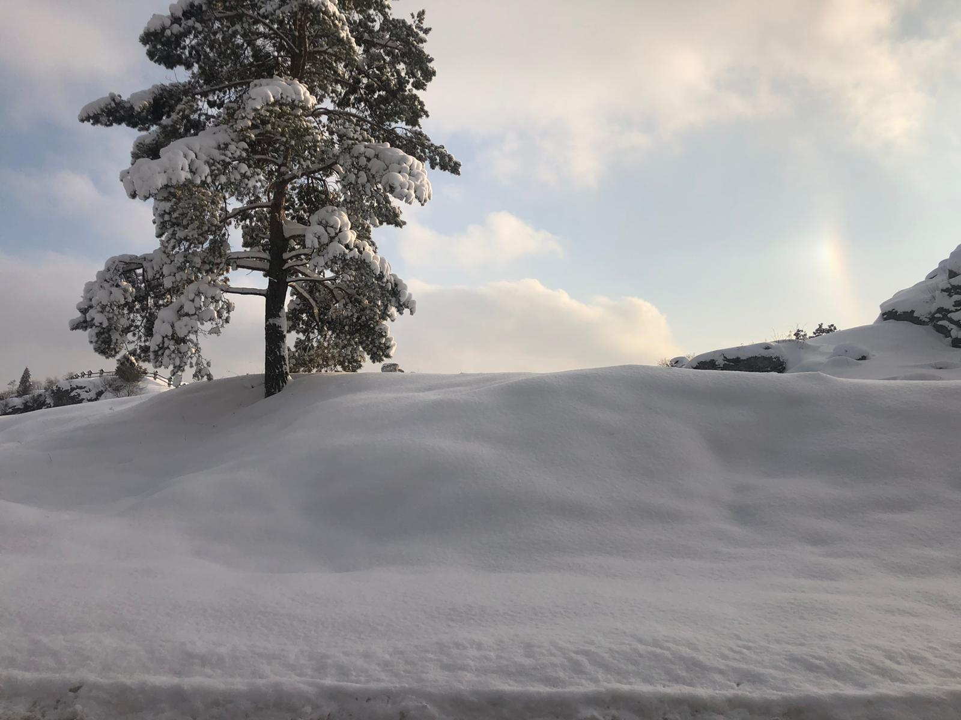

Slide 9
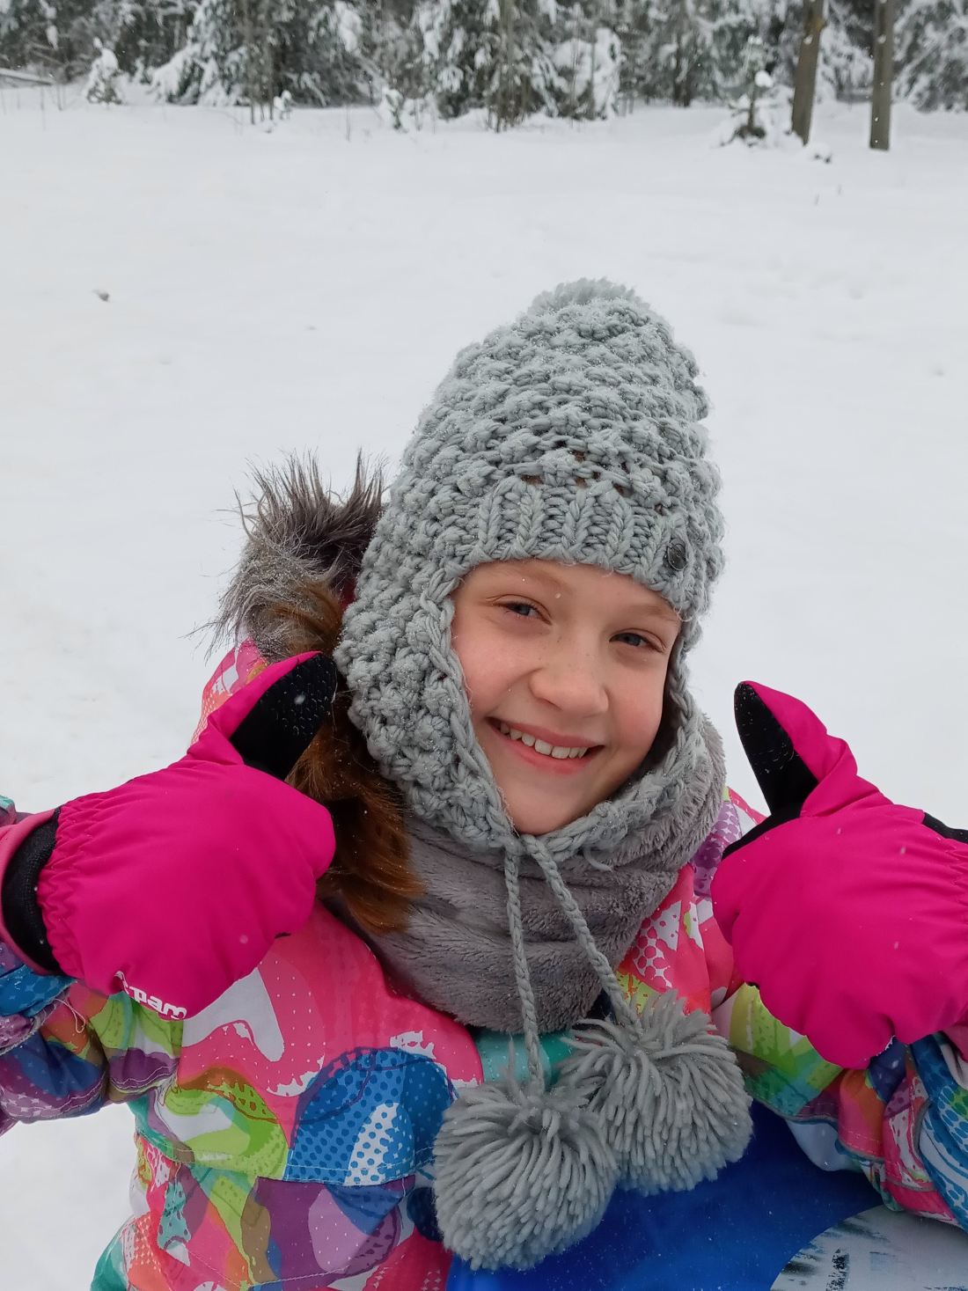
This year, a lot of people took pictures of winter, because probably everyone misses this real winter very much. I also took a lot of winter photos this year and sent them to my friends. We auctioned off who had the most snow. A year ago, there was certainly not that much. When fresh snow arrived, I made snowangels in the snow with my brother and we were not cold at all.

Slide 10
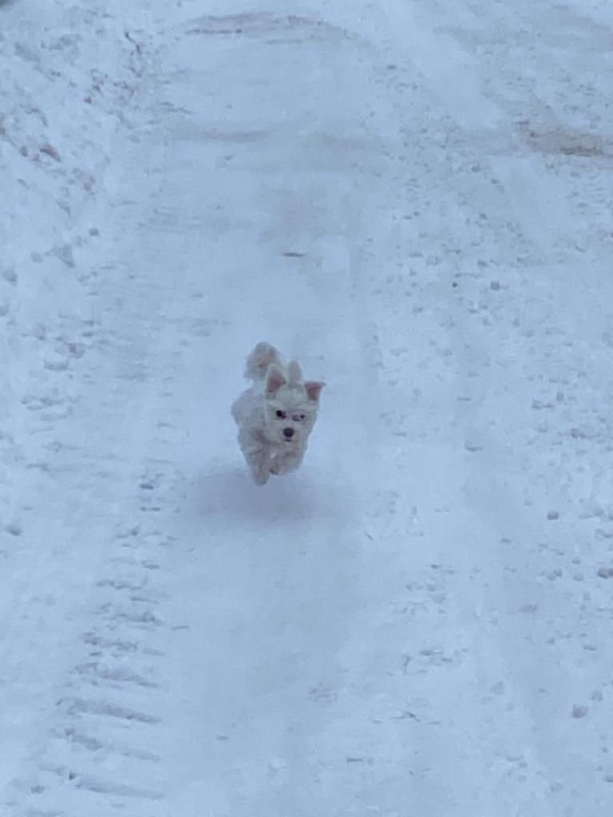
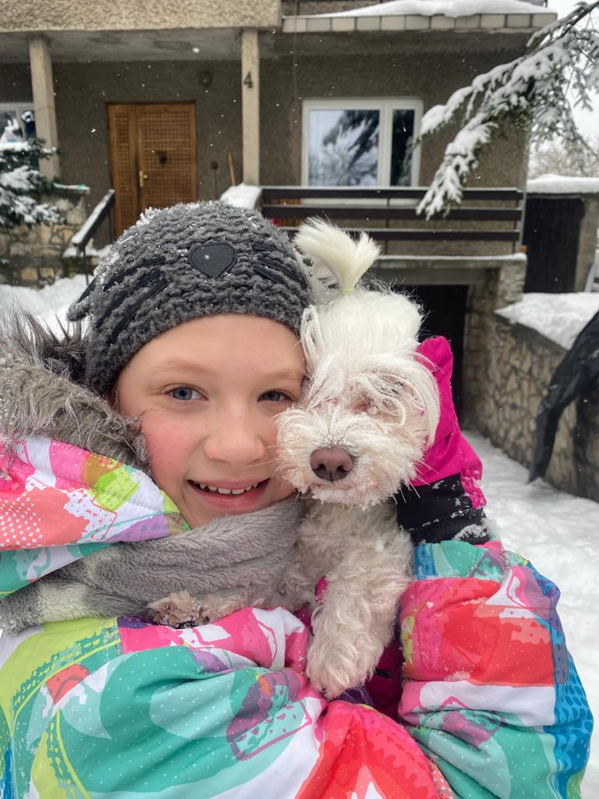
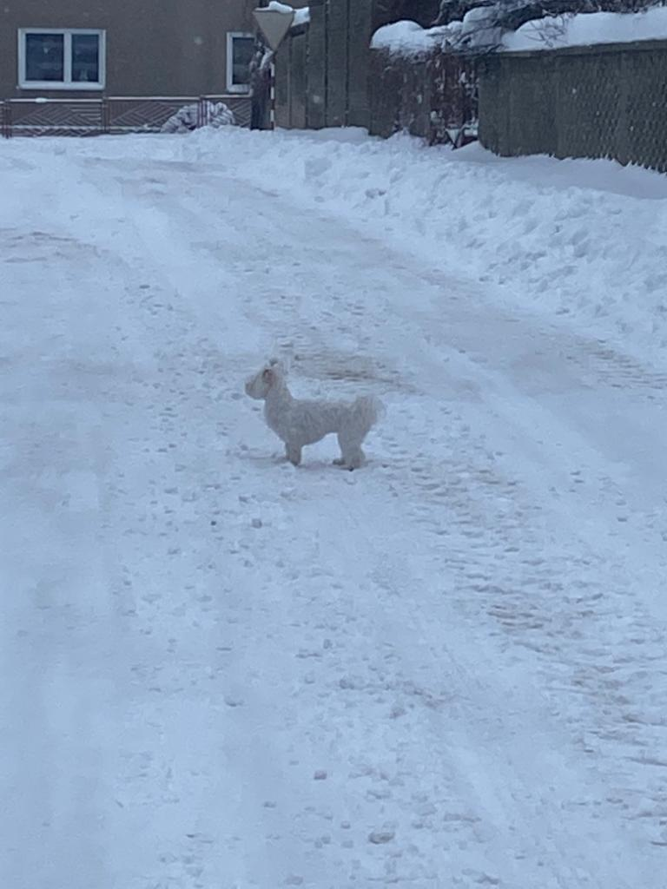
Our dog Mania loves to play in the snow. Together with our dog, we ran in it and lead Mania on a sled.

Slide 11
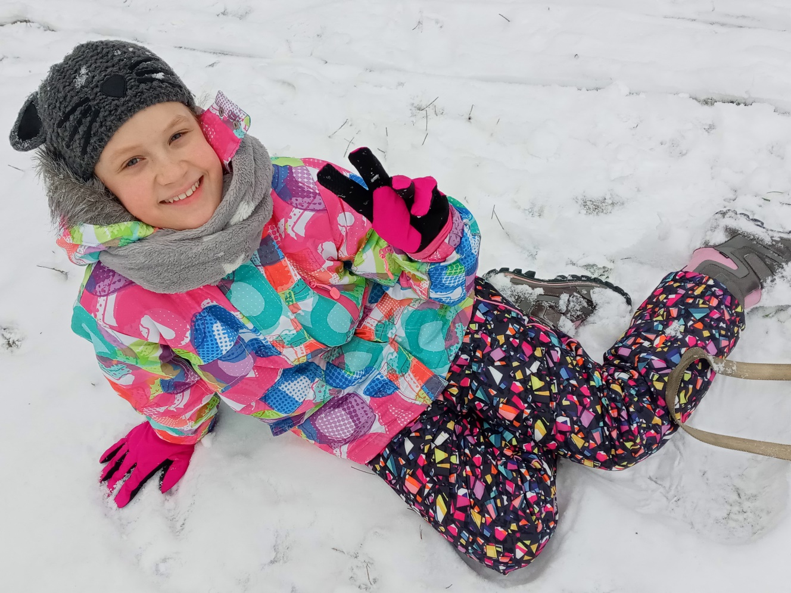
This winter, ice-swimming has become very fashionable, but despite the fashion, I have not decided to go outside without warm clothes and take a photo of myself. I hope the snow will hold a little longer, because we have two more months until the end of winter. Maybe the ski slopes will be opened soon, then I will go skiing, which I love so much.

Slide 12
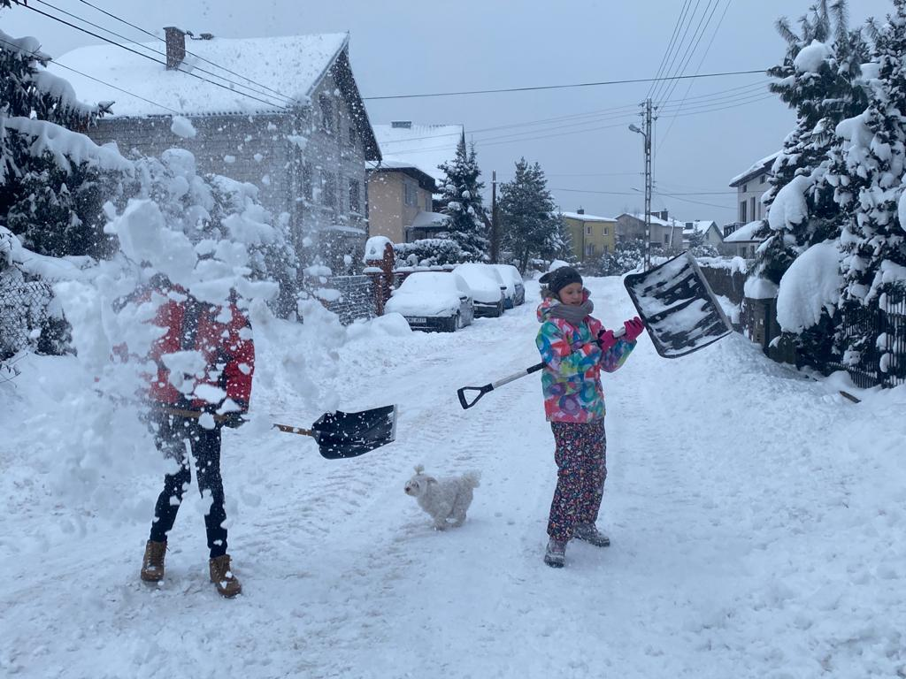

Slide 13
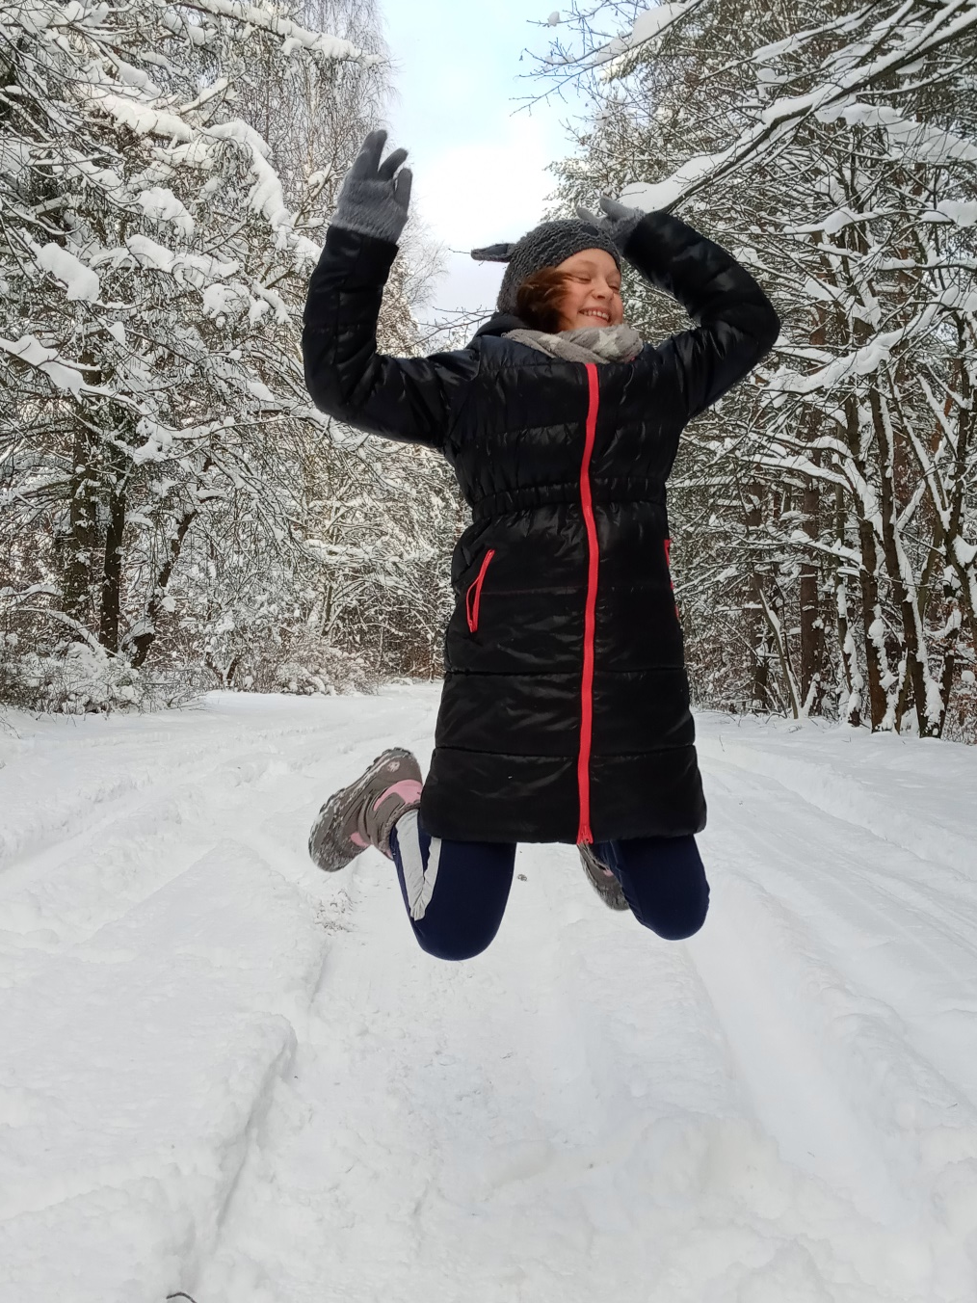
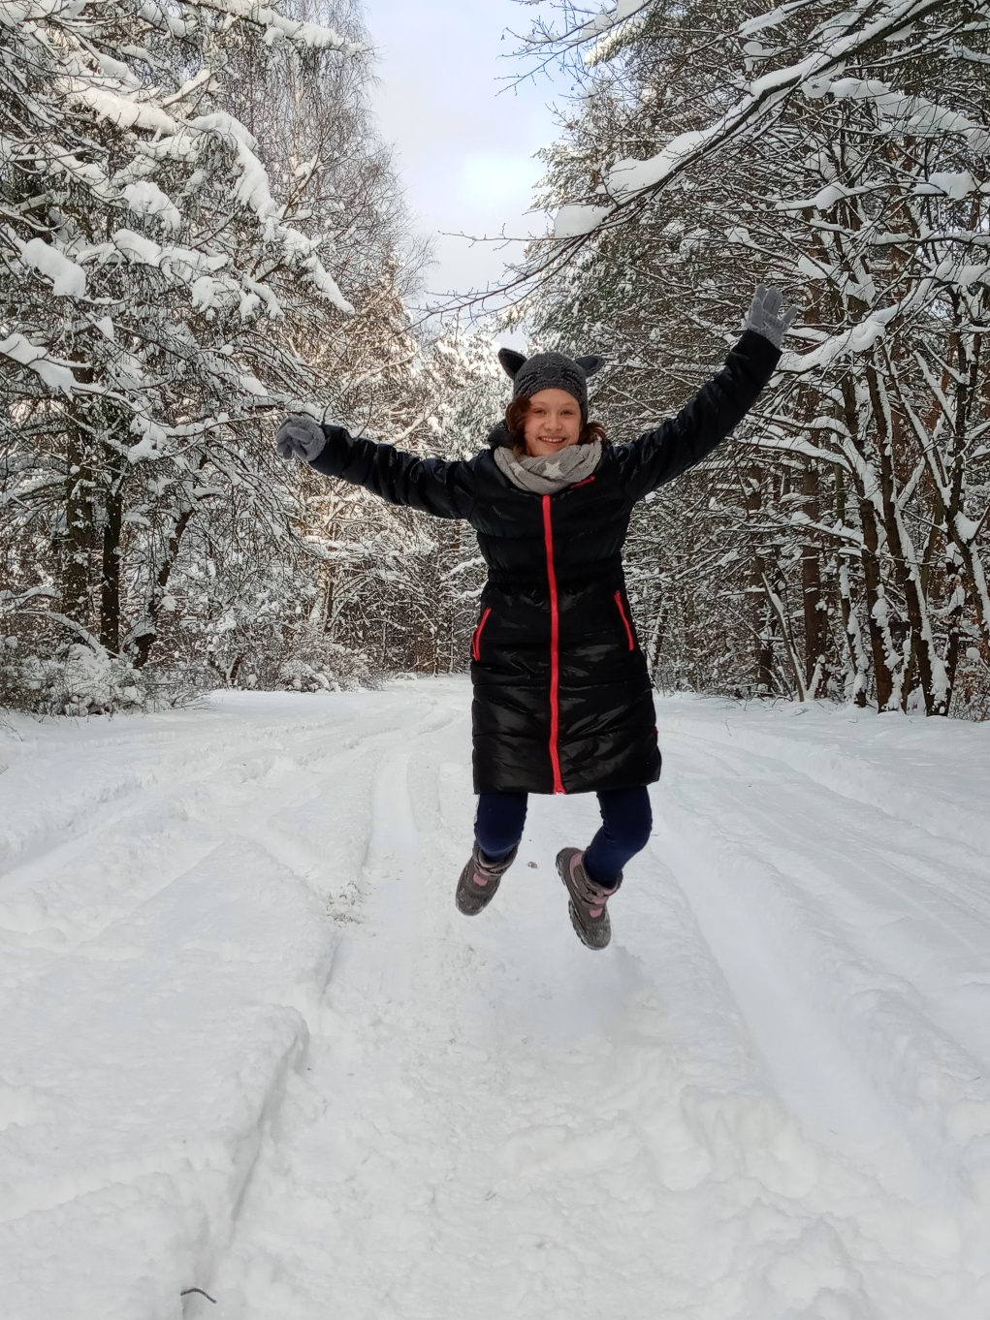
It is a pity that the winter holidays last only two weeks.

